Slide 1
Evaluation of the Saint Paul Early Childhood Scholarship Program
Presented by:
Donna Spiker & Rob Grunewald
For:
Minnesota Early Learning Foundation
April 15, 2011

Slide 2
What will be covered today
Overview of the scholarship program
Evaluation questions and methods
Key findings for Year 3
  Communities
  Programs
  Families
  Children
  Costs and use of scholarship funds

Slide 3

What is the Scholarship Program?
(A refresher)

Slide 4
Market-Based Approach to ECE
Demand-side
  Empower parents with tools: parent mentors, information, and scholarships.
Supply-side
  Must achieve 3- or 4-star Parent Aware rating.
  ECE programs compete for scholarship families.

Slide 5

Goals of the Scholarship Program
School readiness
Parent engagement
More high-quality openings at ECE programs

Slide 6
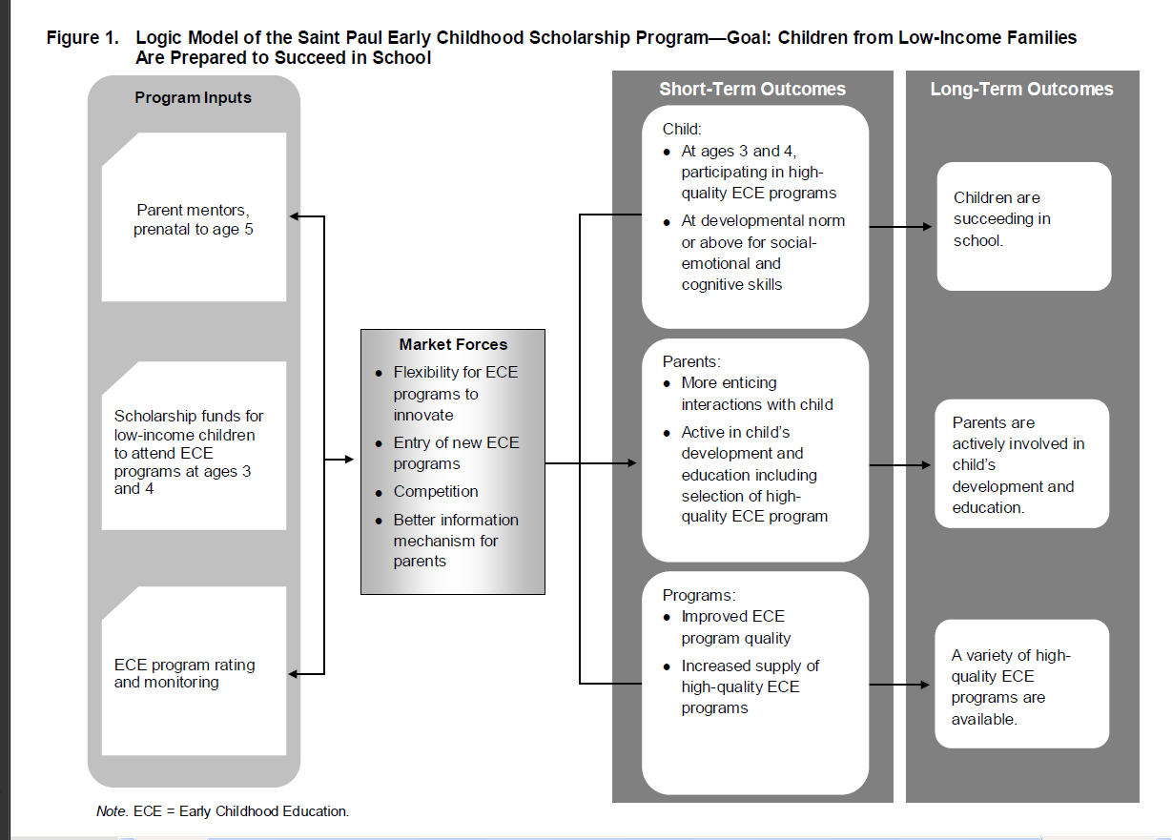

Slide 7
Administration
City of Saint Paul | Coordination and marketing
Resources for Child Caring | Referral assistance, application and scholarship payment processing
Saint Paul-Ramsey County Public Health | Parent mentor coordination and delivery
Minnesota Early Learning Foundation | Fundraising and program development
SRI International | Evaluation

Slide 8
Scholarship Program Eligibility
Residence: Live in Frogtown, North End or Payne-Phalen neighborhoods in Saint Paul
Income: Below 185% of poverty
Child Age: Either age 3 or age 0-1 on September 1st of current school year
Pilot timeframe: January 2008 through August 2011

Slide 9
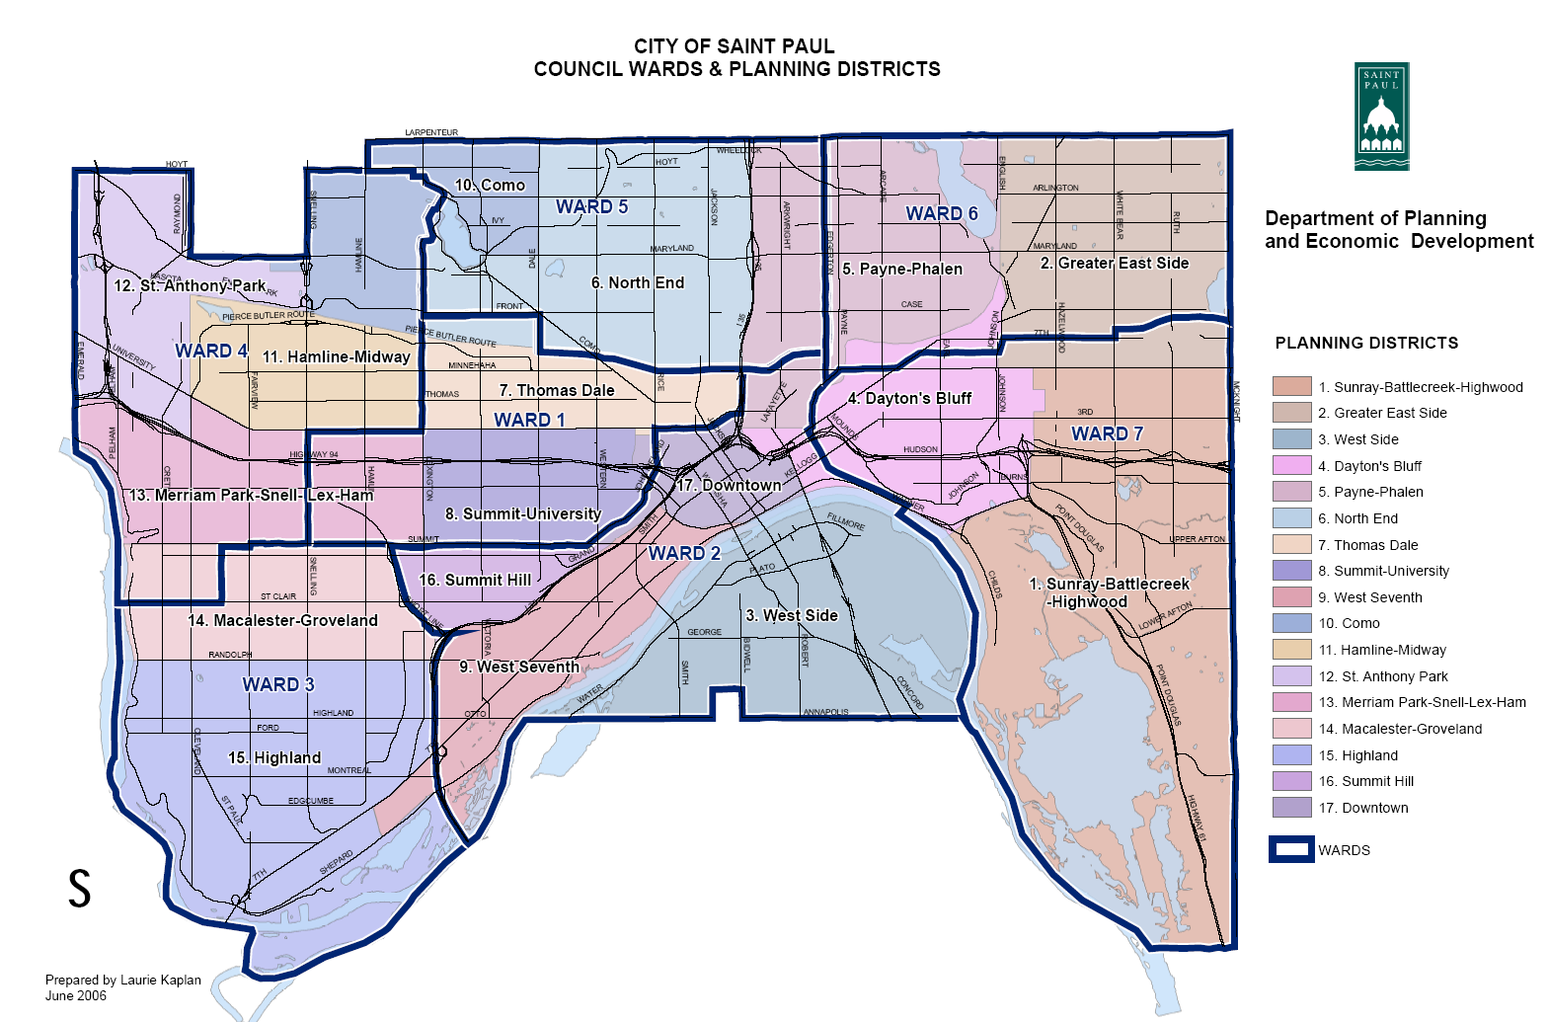
Pilot Area

Slide 10
Evaluation Questions
How were the three inputs/components implemented?
  Increasing access to information and resources (parent mentoring, scholarships) for low-income parents
  Increasing access to high-quality ECE programs for children from low-income households
  Increasing supply and quality of ECE programs in the community

Slide 11
Evaluation Questions (continued)
What impact did the Scholarship Program have on . . .
  Participating children and their families? (child-level)
  Programs participating in the rating system? (program-level)
  Supply/quality of ECE programs in the pilot communities? (community-level)

Slide 12
Methods and Data Sources
Administrative data.
Qualitative interviews and focus groups with key stakeholders at multiple times across implementation.
Data were collected on program characteristics through NACCRRAware and Parent Aware (quality rating system).

Slide 13

Methods and Data Sources (continued)
Program survey
Parent phone interviews
Direct child assessments and teacher checklists (standardized measures)

Slide 14


Findings: Communities
The Saint Paul Early Childhood Scholarship Program, 4/15/2011

Slide 15
Key findings: Communities
Children and families served were diverse and demonstrated a need for access to information and resources to support their children’s development and early learning.
Diversity
  56% of families reported English as home language on the application form.
  30% of the families considered themselves immigrants.
Need
  72% were below 100% FPL.
  51% of families receiving financial assistance from CCAP and/or MFIP.
  59% of parents were working or attending school.
The Saint Paul Early Childhood Scholarship Program, 4/15/2011

Slide 16
Key findings: Communities
Demographic Characteristics of Children and Families
Source: Application data (N = 257)

Slide 17
Key findings: Communities
Overall, implementation went well.
  About 650 children and their families participated in the scholarship program.
  348 children received scholarships to attend high-quality ECE programs (38% of the 924 three- and four-year-olds in districts 6 and 7 living at or below 185% FPL¹).
  Most children stayed in the Scholarship Program for 2 years (86-94%).
¹ According to Census 2000 data, via the Scholarship pilot manual.
Notes:
Cost for 2 years of high quality made fund-raising a challenge…BUT great to have kids in high-quality ECE program for 2 full years

Slide 18
Key findings: Communities
Source: Parent phone interviews.

Slide 19
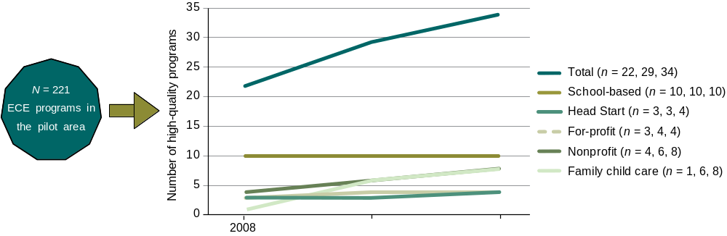
Key findings: Communities
Changes in the Number of High-Quality ECE Programs in the Pilot Area,
from 2008 to 2010
The Saint Paul Early Childhood Scholarship Program, 4/15/2011

Slide 20
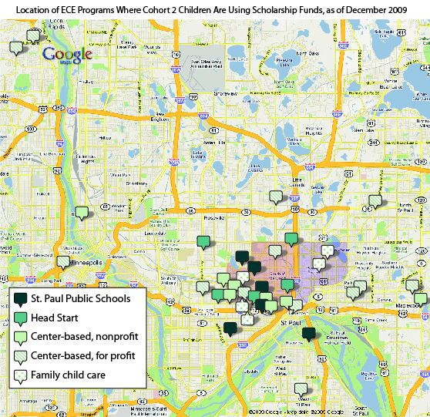
Cohort 2 Children in Their Second Year (December 2009)

Slide 21
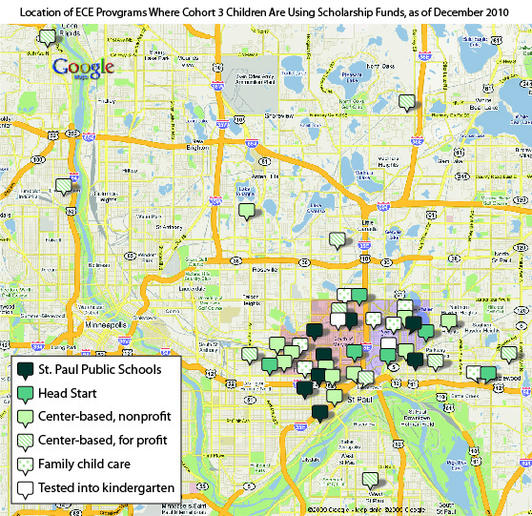
Cohort 3 Children in Their Second Year (December 2010)

Slide 22
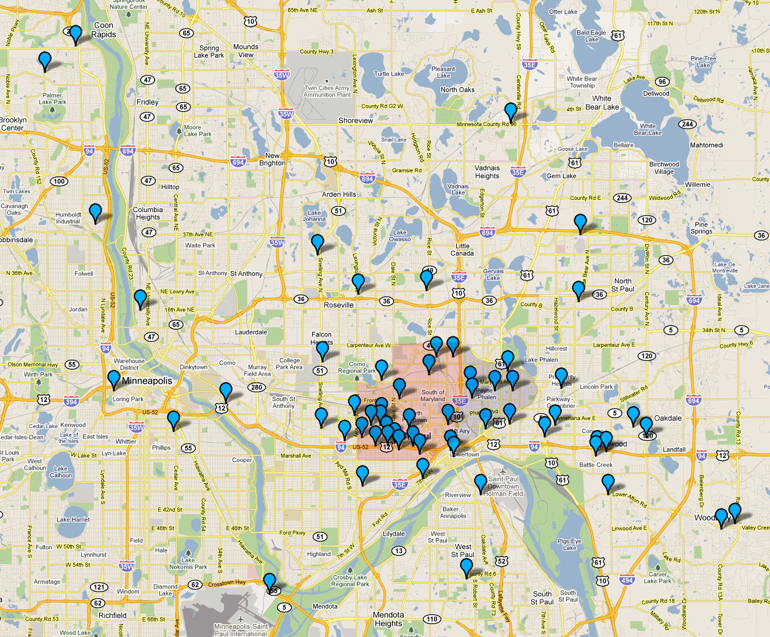
All Programs Ever Attended by Scholarship Children

Slide 23
Key findings: Lessons learned about implementation
Increased support for and awareness of high-quality ECE programs
Enthusiastic support from families and ECE programs
Challenges:
  Transportation
  Recruitment: Person-to-person works best
  Integrating nontuition programs into market-based model
The Saint Paul Early Childhood Scholarship Program, 4/15/2011

Slide 24

Findings: Programs
The Saint Paul Early Childhood Scholarship Program, 4/15/2011

Slide 25
Key findings: Programs
Serving more economically diverse population of children and families.
  55% of the programs reported enrolling more children from low-income households as a result of the scholarship funds.
Improving the quality of learning materials and supporting ongoing operations through the quality grant payments.
Benefitting from the streamlined payment process and being able to support continuity of children’s care and education (especially compared to CCAP).
Notes:
Continuity of care is a major problem with low income children, causes many problems to get good child outcomes; low income and diverse children can get into higher end programs than they ever could with own resources

Slide 26
Key findings: Programs
Primary Uses of the Scholarship Funds by ECE Programs (n = 22)
Source: ECE program survey

Slide 27
Key findings: Programs
Source: ECE program survey
Notes:
Percent of programs reporting “very” or “somewhat” true.

Slide 28
Key findings: Programs
Source: ECE program survey
Notes:
Percent of programs reporting “very” or “somewhat” true.

Slide 29


Findings: Families
The Saint Paul Early Childhood Scholarship Program, 4/15/2011

Slide 30
Key findings: Families
Notes:
Year 2 parent interview rate was very low (n=47 with both baseline and one-year follow-up interview = 18% of the 257 in the evaluation); we report on those with baseline (n=124; 48%)……..adn later will look at baseline compared with K interviews (we hope)

Slide 31
Key findings: Families

Slide 32
Key findings: Families

Slide 33
Key findings: Families
Enthusiastic about the program
Program considered user-friendly
Participation provided school and work opportunities
Strong positive opinions about parent mentors

Slide 34



Findings: Children
The Saint Paul Early Childhood Scholarship Program, 4/15/2011

Slide 35
Key findings: Children
Increasing access and enrollment of participating children in high-quality ECE programs.
Increasing language, early math, and social skills after one year of participation in a high-quality ECE program.
Increasing English language skills in the diverse sample of children (i.e., more children passed the English screener and could be tested in English).
Aggressive behavior problems and attention did not change in the first year of participation.

Slide 36
Key findings: Children
Parents’ Report of Child’s Care Prior to Scholarship Program Enrollment
December 2010
Source: Parent phone interviews (n = 122)

Slide 37
Key findings: Children
Children Enrolled in a Variety of ECE Programs
February 2010
Total enrollment: 232
Source: Administration data

Slide 38
Key findings: Children
Across the first year of enrollment in a high-quality ECE program, children had significant increases in language and early math skills.
  Receptive language scores increased 5 points after one year, equivalent to a moderate effect size of 0.33.
  At baseline, 23% of children could not be assessed in English (ELLs), but one year later, only 15% could not be assessed in English.
  At baseline at age 3, 18% had very low math scores, but one year later only 7% had very low scores.
The Saint Paul Early Childhood Scholarship Program, 4/15/2011
Notes:
Math low scores = a SD below the mean of 100 (p<.001).
Hmong, Karen, Sololi, Korean, Vietnamese

Slide 39
Key findings: Children
(12.2)
(12.9)
***
(16.8)
(20.8)
*** p < .001
Source: Direct child assessments

Slide 40
Key findings: Children
Between baseline and one year later:
  Children’s social skills showed significant improvements.
  Scores on aggressive behavior problems and on attention and task-persistence ratings showed no significant changes.
The Saint Paul Early Childhood Scholarship Program, 4/15/2011

Slide 41
Key findings: Children
**
Mean score (SD)
** p < .01
Source: Teacher checklists

Slide 42
Findings: Cost Study
(Conducted by RAND)
The Saint Paul Early Childhood Scholarship Program, 4/15/2011

Slide 43
Key findings: Cost study
Sample of 12 of the 47 sites that received scholarship funding, representing all types of programs:
  Head Start, school-based, for- and nonprofit center-based, family child care
  Full-day and half-day
  Year-round and academic year
Site enrollment size varied from under 20 children to over 100 children

Slide 44
Key findings: Cost study
Data were collected on:
Expenditures and staffing
Other in-kind resources
  Volunteer hours, donated supplies, subsidized building space
Services and program features
  Transportation, vision and hearing screening, mental health consultation, literacy coaching, and other services
Notes:
Ingredients approach to cost data = all costs of a program so you can compares equally across all program types - e.g., school-based programs do not pay rent, but we estimate market rates for rent in this cost approach

Slide 45
Key findings: Cost study
Costs associated with providing high-quality ECE varied widely from site to site.
  Yearly costs ranged from $7,000 to $25,500, with per-child-hour ranging from $3.50 to $19.00.
  Head Start and public school-based centers had the highest annual cost and hourly costs per child.
    RAND attributes these differences at least partially to the increased number of nonteacher staff available at these programs.

Slide 46
Key findings: Cost study
Revenue sources also varied widely.
  Overall, at least half of the students served by the sites were low-income.
  Most sites relied heavily on scholarships, donations, and funds other than parent fees.
  Across the 9 sites receiving scholarship funds at the time of interview, scholarship funds accounted for 1% - 79% of total revenue.

Slide 47
Key findings: Cost study
Sources of Support for Sampled ECE Sites
 | Family child care |  | For-profit centers |  |  | Nonprofit centers |  |  | Head Start centers |  |  | Public pre-K
 | A | B | C | D | E | F | G | H | I | J | K | L
Share of revenue and other support (%)
Scholarship payments | 79 | 9 | 1 | 8 | 36 | 14 | 4 | 11 | 0 | 25 | 0 | 0
Government subsidies | 21 | 19 | 76 | ** | 45 | 30 | 9 | 8 | 88 | 69 | 86 | 100
Parent fees | 1 | 63 | 11 | ** | 9 | 6 | 42 | 30 | 0 | 0 | 0 | 0
Donations | 0 | 9 | 11 | ** | 9 | 50 | 45 | 51 | 12 | 6 | 14 | 0
** Information not available, or not available at a disaggregated level and included with another line item.

Slide 48
Next steps for remainder of 2011
Complete the kindergarten outcome assessments with final cohort of scholarship children in fall 2011
Complete kindergarten outcome assessments with comparison group children in fall 2011
Conduct site visits to learn about final year of implementation and recommendations for future replications

Slide 49


Questions & Comments
The Saint Paul Early Childhood Scholarship Program, 4/15/2011
48

